Slide 2
Tips for Turning a .NET Developer into a CRM Developer in a Week
Mitch Milam | xRM Coaches

Slide 3
Agenda
General thoughts
Things to know about Dynamics CRM
Things to know about JavaScript
Things to know about .NET and CRM

Slide 4
General Thoughts
DO NOT let your developers dive into a code-first solution for every problem
Their job should be to create solutions, not write code
If problems persist, make sure the new developers understand the concept

Slide 5
Know and Understand Dynamics CRM
Developers need to know:
What it does
How to do it
In a nutshell:
Dynamics CRM provides the plumbing
Developers provide the fixtures

Slide 6
Dynamics CRM: What to Know
How to create Entities and Fields
How to link Entities via relationships
Creating and maintaining Forms and Views
Working with Solutions

Slide 7
Getting Started

Slide 8
Download and Explorer the SDK
CRM 4.0
http://www.microsoft.com/download/details.aspx?id=38
CRM 2011
http://www.microsoft.com/download/details.aspx?id=24004
CRM 2013
http://www.microsoft.com/download/details.aspx?id=40321

Slide 9
Know and Understand Your Tools
Lots of outstanding resources are available
Attend my Tuesday session:
Dynamics CRM Developer Tools Hit List
Attend the Wednesday session:
Techie Talk: The Techie 'Tool Box' Panel

Slide 10
Read, Read, Read
Blogs
Forum posts
Books

Slide 11
When in Doubt, Search
What you are trying to do has probably already been done
Don't let a quick Internet search stand in the way of you accomplishing a task
Do not recreate, the hard way, what others have already done
When still in doubt, ask.
http://community.crmug.com/Home
http://community.dynamics.com/crm/default.aspx

Slide 12
Choosing a Development Path
Working with the Dynamics CRM Client
JavaScript Development
Dynamic form customization
Enhancing the client experience
Working behind the scenes
.NET development
Integration with other systems
Plug-ins
Custom workflow activities

Slide 13
Using JavaScript

Slide 14
JavaScript: Things to know
Working with Web Resources:
Design and organization
Associating to a form
Form Event Model
Working with Tabs and sections
Working with field controls and attributes

Slide 15
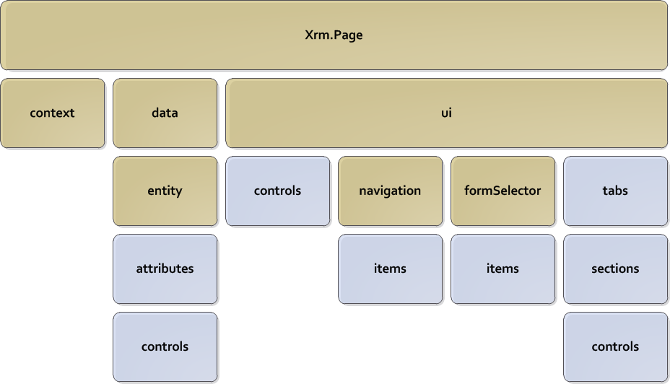
Xrm.Page Object Model

Slide 16
XrmSvcToolkit
Provides the JavaScript programmer with the following capabilities:
Create, update, and delete records
Retrieve data
Execute SDK calls

Slide 17
.NET: The High Points
All developers should know:
Which reference assemblies are required
Special CRM data types and classes
How IDs are supplied or created
How CRM security works

Slide 18
.NET: The High Points (cont.)
All developers should know how to:
Connect to a CRM system
Create, update, and delete data
Use the Request/Response messaging system of the SDK
Retrieve data (there are several methods)

Slide 19
Using .NET and CRM
How is .NET used?
Integration with external systems (legacy databases, etc.)
Can be used to perform specialty or batch operations
Applications such as custom web portals

Slide 20
Advanced .NET
Plug-ins
Add custom business logic to CRM
Custom Workflow Activities
Add custom actions that may be used by users and administrators creating workflows

Slide 21
All About Plug-Ins
Plug-ins can perform a vast array of automation tasks
They can make your uses more productive
They can stop your CRM system from working, if done incorrectly

Slide 22
Conclusion
Dynamics CRM Development is not rocket science, there is just a lot to know.

Slide 23
Questions?

Slide 24



Mitch Milam
mitch@xrmcoaches.com
@mitchmilam
blogs.infinite-x.net
xrmcoaches.com
crmaccelerators.net
rockmycrm.com

Slide 25
THANK YOU
Please fill out your evaluation.

